Slide 1

Getting Started with
Stock Synthesis (SS)

Slide 2
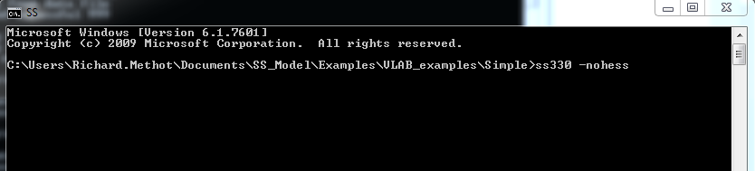
Running SS
SS typically runs in a command window
A separate guide is available to run SS using the Stock Synthesis Interface (ss_gui.exe)

Slide 3
SS Files Types
Output for debugging:
Warning.sso
Echoinput.sso
ParmTrace.sso
4 Input files:
Starter.ss
MyControlFile.ss
MyDataFile.ss
Forecast.ss
Executable
SS.exe
Output with results:
ss_summary.sso
Report.sso
CompReport.sso
Covar.sso
Forecast-report.sso
ss.par
Shows all input options;
and simulated data.
Output that mirrors input:
Starter.ss_new
Control.ss_new
Data.ss_new
Forecast.ss_new
Wtatage.ss_new

Slide 4

The four input files read by ss.exe
Starter.ss: Required file containing filenames of the data file and the control file plus other run controls.
Datafile: File containing model dimensions and the data.
Control file: File containing set-up for the parameters.
Forecast.ss: File containing specifications for reference points and forecasts.

Slide 5
Two optional input files.
SS.par: Previously created parameter file that can be read to overwrite the initial parameter values in the control file.
Wtatage.ss: File containing empirical input of body weight by fleet and population and empirical fecundity-at-age.

Slide 6
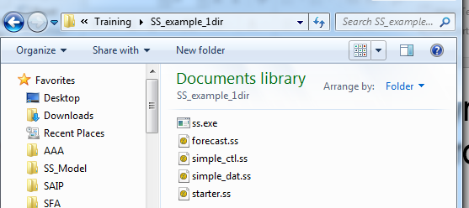
Running SS -
1 folder approach.
Create a folder and add:
ss.exe
  ssopt.exe (Optional, for running faster without internal checks.)
starter.ss
Control File (Must match name in starter.ss.)
Data File (Must match name in starter.ss.)
forecast.ss
Conditional files:
  wtatage.ss (Only if doing empirical wt-at-age approach.)
  ss.par (to continue from a previous run)
Notes:
Download our simpler example

Slide 7
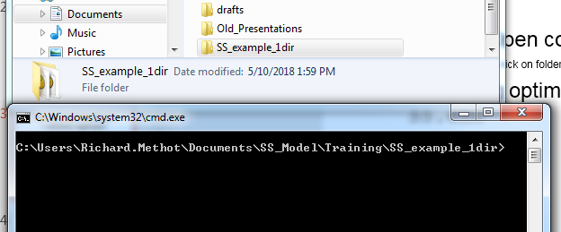
Starting SS
Click here to highlight.
Then shift right-click to get to “open command window here” option.
Which opens cmd.exe in that directory.
Then type ss and hit <enter>
Notes:
Download our simpler example

Slide 8
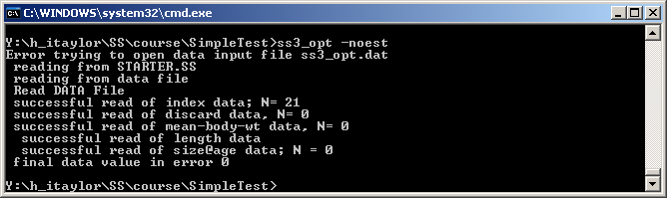
Command Line Messages
Ignore message: Error trying to open data input file ss.dat
If you get past Estimating…please wait… then the structure of the inputs is OK.
Volume of information controlled in starter.ss file:
1 # run display detail (0,1,2)
Middle level (1) is usually best.

Slide 9
SS Run
SS then proceeds immediately to pre-processing of the data, creation of internal parameter labels, etc.
  Some checks are written to Echoinput.sso.
  Problems written to Warnings.sso.
Then go to the Procedure section where iterative parameter changes are made by ADMB to minimize the –logL.
When ADMB achieves convergence, control passes to the sd_phase for calculation of parameter variance (unless –nohess option). After the sd_phase, it then goes to the benchmark and forecast code section, and then to the final reporting.
Results will be written to the same directory

Slide 10
Pro/Con of 1 folder approach
Pro: obvious which SS version used to produce results, but the SS version ID is shown at top of all output files
Con: if you update your version of SS, then you may need to update it in many folders. This can be overcome by the 2 folder approach

Slide 11
Run SS – 2 folder approach
Folder 1 contains one file, ss.exe
Folder 2 is the model user folder. It contains the ss input files plus a batch file named SS330.bat
The first line of SS330.bat refers to the folder containing your copy of SS.exe
  C:\MyDocuments\Assessments\SSmodel\SS.exe %1 %2 %3 %4
Open the DOS window in the model user folder
With this approach, you can have one (or more) folders with various versions of SS, and many folders each with one (or more) versions of batch files that point to various versions of SS.

Slide 12
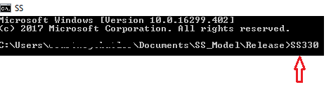
Continued
5. Type SS330 in the DOS window which will start SS330.bat file.
6. SS330.bat will open SS.EXE which the reads starter.ss, the datafile.dat, and the forecast.ss. It then the reads controlfile.ctl file named in starter.ss.

Slide 13
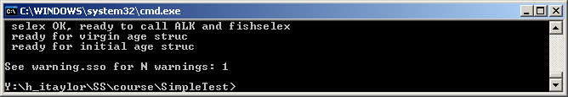
Warning.sso File
Contains a list of warnings generated during program execution.
Note in command line if N warnings > 0
N warnings include:
  Notification of errors in input files.
  Some advice on parameter settings.

Slide 14
Screen output at the end of a run.
5 10 -log(L): 1286.12 Spbio: 49655.1 4982.51
writing big output now
<Hessian would go here>
Finish time: Wed May 11 21:53:27 2011
Elapsed time: 0 hours, 6 minutes, 31 seconds.
Final gradient: 6.54155e-005
Finished writing COVAR.SSO
got Fspr 0.116474 0.4
got_Btgt 0.147638 0.342
got Fmsy 0.105059 3262.56
Do Forecast 2011
Process STD quant
STD OK …….
writing big output now
finished big report
finished summary report
finished rebuilder report
N_nudata: 3
finished nudata report
Write new starter file
Write new forecast file
Write new control file
finished nucontrol report
!! Run has completed !! No warnings
C:\SS2\SS3_Examples\Ver320\Simple>del ss3.r0*

Slide 15
Examining the Output
Examine Warnings.sso for issues and suggestions.
Read the output and results into one of the these programs:
  R4SS
  SS_Output-X.xslm
  SSI (Stock Synthesis Interface)
The results will included the following:
  Calculated selectivity, biomass, F time series, numbers-at-age, fit to data, etc.
Notes:
“C

Slide 16
What to do when SS doesn't run?
  Make sure all file names and directories / folders are named correctly. If file names and directories are named incorrectly SS will not be able to find the file.
  If it starts to read files and then crashes:
    Look at Warnings.sso.
    Look at Echoinput.sso and work backwards from the bottom.
    Look for where it doesn't match your inputs.
    Consult the Stock Synthesis User Manual.
      For further information please refer to SS User Manual - Section 13.1.5 “Re-Starting a Run” and Section 13.2 “Debugging Tips.”

Slide 17
If the input is OK and then crashes.
If model crashes soon after starting the run, or if NAN messages appears on the screen, then:
  Restart SS with the –noest option. This will read files, produce report output, and produce *.ss_new files.
Read Report.sso and Compreport.sso into R4SS or SS_Output-X.xlsm or the SSI to examine the details.
  May show which likelihood component and which data have the NAN calculation.

Slide 18
If SS runs, but there is a large gradient at end.
Re-start from final values in the previous run by changing the Starter.ss file to:
  1 # 0=use init values in control file
  1=use ss.par
Examine Report.sso for parameters that are on or near bounds.
Examine residuals for gross lack-of-fit. If the residual are bad, ADMB may not be able to figure out which way to go.
Notes:
“Re-start from final values in previous run by changing starter.ss file to: “ Briefly explain where and how to change the starter.ss file.

Slide 19
Bad Hessian
Output file Report.sso includes information on parameter uncertainty.
In some cases, Hessian Matrix does not invert, and full the Report file is not produced.
Run model again using the following:
  ss3 –nohess
  Optional start from the final values in the previous run by changing Starter File to:
  1 # 0=use init values in control file; 1=use ss3.par

Slide 20
Advanced command line options.
Options can be added to command line (ADMB).
  Run without estimating anything: SS3 -noest
  Skip standard errors (for quicker results, or to get Report.sso if Hessian does not invert): SS3 -nohess
  Run MCMC:
  SS3 -mcmc 100000 -mcsave 100
  (Runs 100,000 draws and saves every 100th.)
  SS3 -mceval
  (Evaluates saved draws.)
  List all command line options: SS3 -?
More info in ADMB Manual (Chapter 12: Command line options) http://admb-project.googlecode.com/files/admb.pdf

Slide 21
Some ADMB Tips
If you receive a memory allocation error.
  Try SS3 –ams XXXXXX (i.e., 200000).
  Or free up memory on your computer.
If it runs slow:
  Probably writing to cmpdiff.tmp & gradfil1.tmp
  Use –cbs XXXXXXX until cmpdiff.tmp=0 Mb
  Use –gbs XXXXXXX until gradfil.tmp=0 Mb
When the model is running:
  Press ‘n’: immediately goes to next phase.
  Press ‘q’: immediately quits estimation.

Slide 22
Associated Tools
Any text
editor
SSI
Helper Excel
Sheets
Output for debugging
Warning.sso
Echoinput.sso
ParmTrace.sso
Input files
Starter.ss
MyControlFile.ss
MyDataFile.ss
Forecast.ss
R4SS
Executable
SS.exe
Output with results
Report.sso
CompReport.sso
Covar.sso
Forecast-report.sso
Excel
Viewer
To get comments
or simulated data.
Output that mirrors input
Starter.ss_new
Control.ss_new
Data.ss_new
Forecast.ss_new
R4SS
SSI
Any text
editor
Notes:
On the “Any text editor” slide make suggestions or recommend a text editor a SS User can use. Also, I would tell the user where to download the Helper Excel Sheets for SS.

Slide 23
Creating and modifying files.
Start from an existing data.ss_new file (which will be heavily annotated by SS) as a template; or start from the SS_330_Data_Input.xlsx spreadsheet.
Replace the data content with your data and update the data counters and descriptors.
Save as a different filename and insert this new filename in the starter.ss file.
Do the same for the parameter file starting from an SS annotated control.ss_new.

Slide 24
Where Outputs files can be viewed.
Many output files are created.
  Report.sso, Forecast-report.sso, etc.
R4SS can read these files into R.
  Creates a list of quantities.
  Can create plots.
SSI (Stock Synthesis Interface)
  Can show plots from ss_summary.sso .

Slide 25
How to get additional help?
SS User Manual.
SS – VLAB public website:
  https://vlab.ncep.noaa.gov/web/stock-synthesis
SSI User Guide.
Other users and models.
SS Google Site.
Fisheries Research Special Issue:
  http://www.capamresearch.org/

